Slide 1
Human Activity Recognition
https://www.yellowtrace.com.au/human-motion-sculpture/

Slide 2
WHAT to find here
What is Human Activity Recognition
Chosen movements
How we collected the data
How we build the dataset
Data Exploration
Chosen model and why
Results and interpretation

Slide 3
WHAT IS HAR?
HUMAN ACTIVITY RECOGNITION (HAR)
The process of processing and analyzing human action behaviors, and then, performing a process of identifying and classifying the movements.

Slide 4
SAMBA
WALKING
https://www.hindustantimes.com/fitness/walking-regularly-for-40-minutes-makes-your-heart-stronger-here-s-what-science-says/story-0Xi8lSlSBma8uhkxFwbsYI.html
chosen movements
SALSA
WALKING DOWNSTAIRS
https://www.everydayhealth.com/specialists/healthy-living/benefits-of-going-down-stairs/

Slide 5
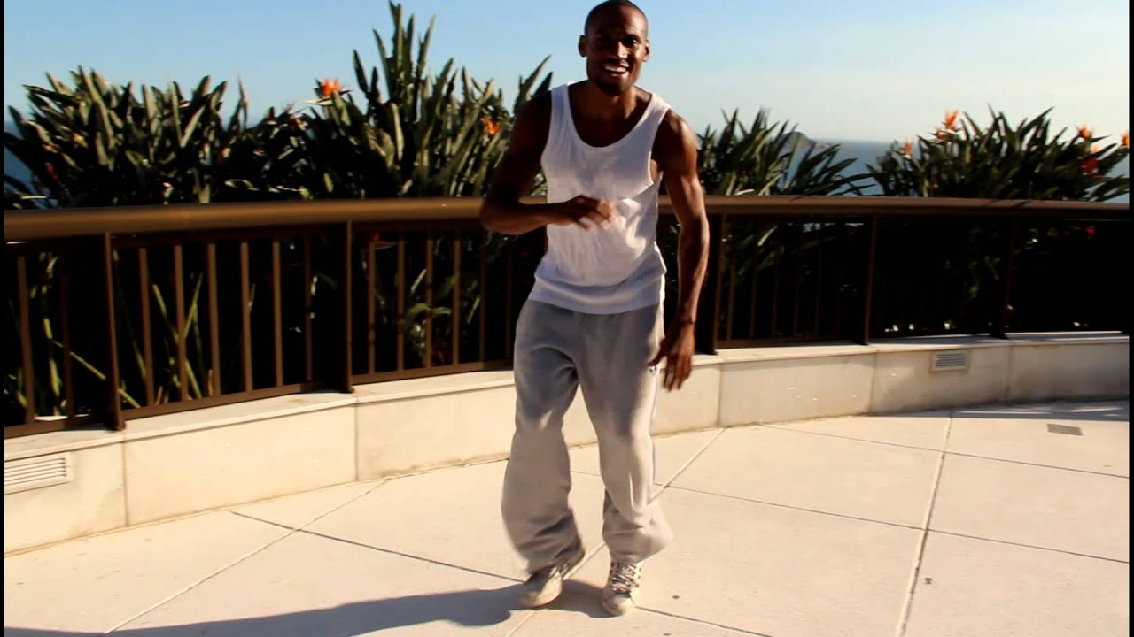
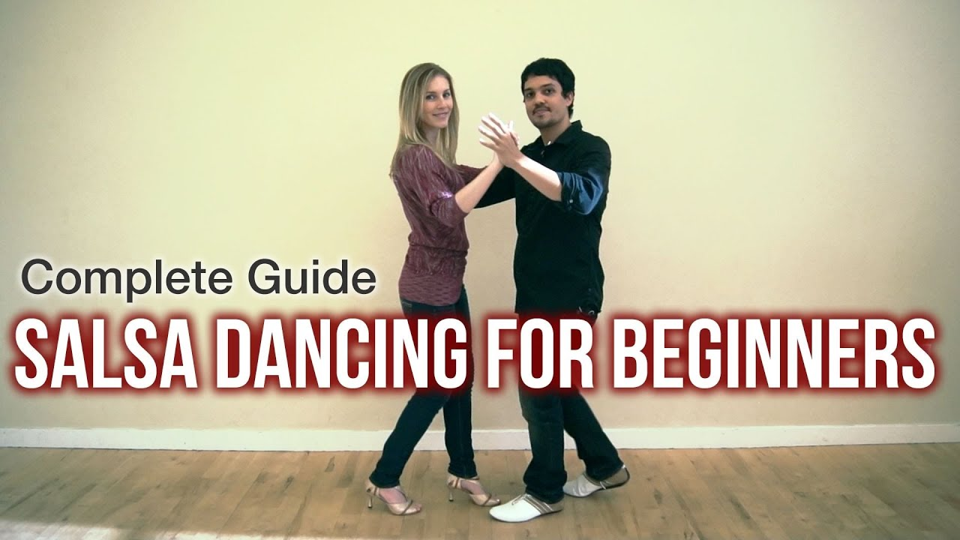

Slide 6
how we recorded this
+
+
collect data
PROCESS data
10x for movement
during 1 min

Slide 7
How could we work together?
storing
data
coding
together

Slide 8
dataset
g-Force Linear Accelerometer Gyroscope
time | gFx | gFy | gFz | ax | ay | az | wx | wy | wz
(9 variables x 5 measurements) + label = 46 variables
std | max | min | mean | number_of_peaks | label

Slide 9
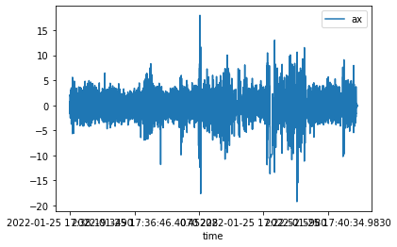
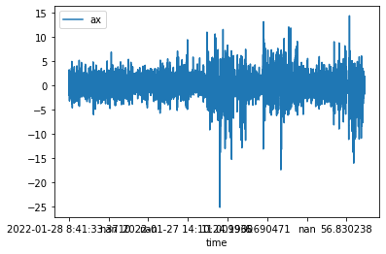
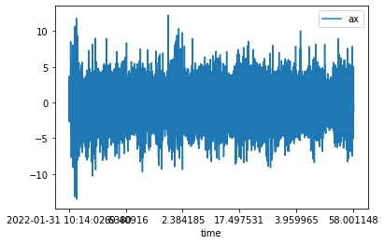
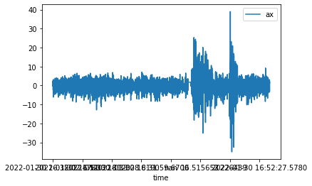
data exploration
WALKING
WALKING DOWNSTAIRS
SALSA
samba

Slide 10
model chosen
We choose this model because…

Slide 11
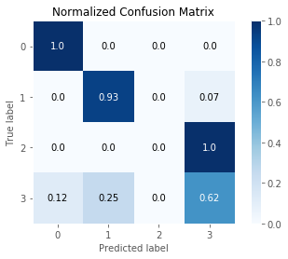
results
ACCURACY: 80%
CONFUSION MATRIX
Precision:
Recall:

Slide 12
interpretation
Which movement the model predicted best
How the model differentiated the two dance styles
What could still be improved in the model

Slide 13
THANK YOU!

Slide 14
CHALLENGES
We would deal with a great amount of data (every observation in the dataset is a summary of many records through time).
Working together on this project was not an easy task.

